Slide 1
INTRODUCTION TO PYTHON

Slide 2





FULL STACK DEVELOPMENT
Front End (Client Side)
Back End (Server Side)
Server
Php, Asp.net
Java, Node JS, Python
Database
SQL Server, Oracle, My SQL, Mongo DB
HTML, CSS, JavaScript
(User Interface)

Slide 3
INTRODUCTION
Created by Guido van Rossum in 1991.
General Purpose programming language.
Interpreted language.
Dynamically typed language.
Object Oriented Programming language.
Fastest growing language

Slide 4
HISTORY
Python laid its foundation in the late 1980s.
The implementation of Python was started in the December 1989 by Guido van Rossum at CWI (centrum wiskunde & informatica) in Netherland.
In February 1991, van Rossum published the code (labeled version 0.9.0)
Python is influenced by following programming languages:
ABC language.
Modula-3
Latest stable release: 3.10.7 (06-09-2022)

Slide 5
FEATURES
Free and Open Source.
High Level Language
Easy to Learn and Use(easy syntax).
Python is a Portable language
Large Standard Library

Slide 6
Example:
In C :
#include <stdio.h>
#include <conio.h
void main()
{
printf(“Hello World”);
getch();
}
In python :
print(“Hello World”)

Slide 7
USES OF PYTHON
Beginners level language
Multipurpose language
Used for:-
Web development
Machine learning
Web scraping
Game development
Desktop app

Slide 8
Job Opportunities
Software Engineer
Software Developer
Web Developer
Data Analyst
Machine Learning Engineer

Slide 9





Major Websites Built with Python:
Google
Instagram
Netflix
Spotify
YouTube etc.

Slide 10
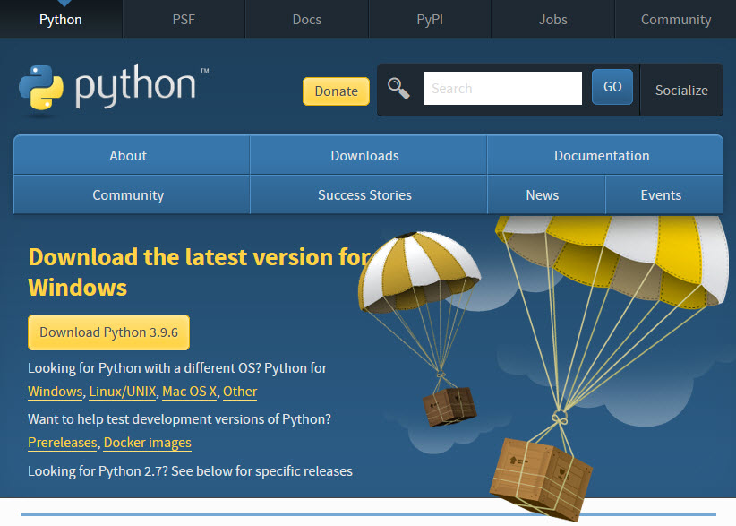
ENVIRONMENTAL SETUP
Python IDLE-Integrated Development And Learning Environment
Visit the link https://www.python.org/downloads/ to download the latest release of Python.
Add Python to Path
Visual Studio Code
Visit the link https://code.visualstudio.com/download and download.

Slide 11
Run a Program:
Command prompt
A command line interpreter application.
IDLE(integrated development and learning environment)
a default editor that comes with Python.
IDE(integrated development environment)
enables programmers to consolidate the different aspects of writing a computer program.
Perform variety of functions

Slide 12
Create folder
Create file(.py)
print()
how to run a code(3 methods)
concatenate string
Store values into variables
Comment
input()
Indentation

Slide 13
PYTHON IDENTIFIERS
Starts with a letter A to Z or a to z or an underscore (_) followed by zero or more letters, underscores and digits (0 to9).
No special characters @, $, and% within identifiers.
Do not start with digits; use digits in between or end.
Case sensitive programming language.
Class names start with an uppercase letter.
Keywords are reserved and cant be used as identifiers.

Slide 14
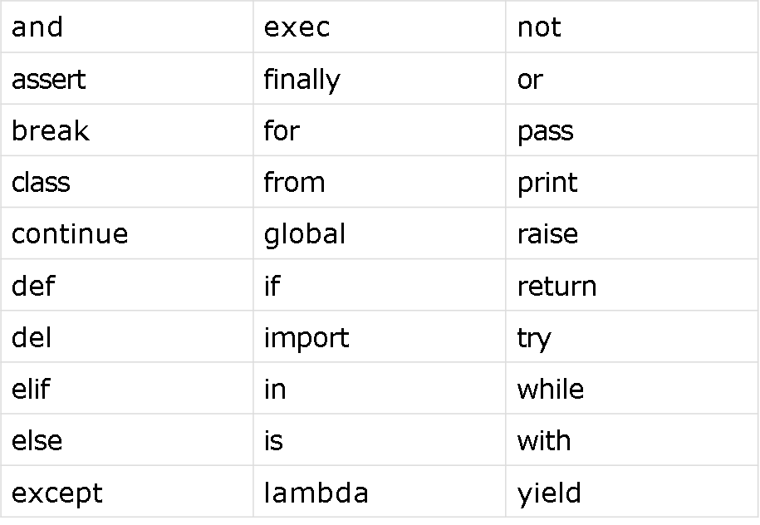
KEYWORDS

Slide 15
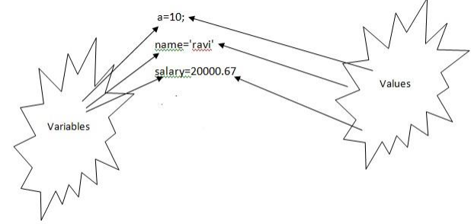
VARIABLES
Name which is used to refer memory location.
Variable used to hold value.
Don't need to specify the type of variable.

Slide 16
DATA TYPES
Immutable :
Integer
Float
Boolean
String
Tuple
type() function which returns the type of the variable passed
Mutable :
List
Set
Dictionary

Slide 17
OPERATORS
Responsible for a particular operation between two operands.
Arithmetic operators
Comparison operators
Assignment Operators
Logical Operators
Membership Operators
Identity Operators

Slide 18
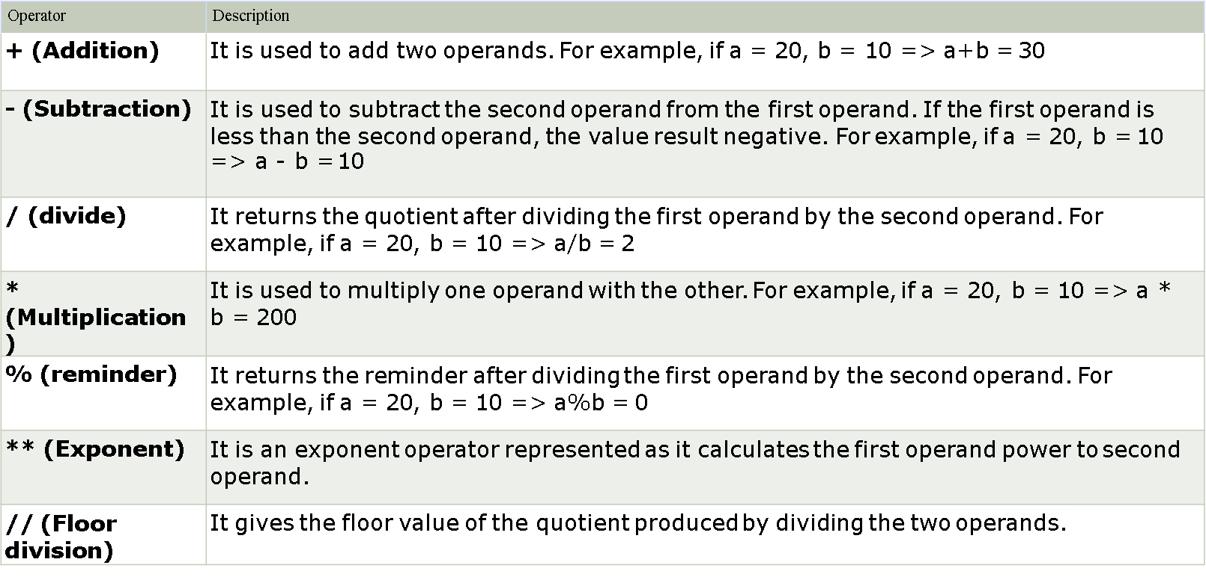
ARITHMETIC OPERATORS

Slide 19
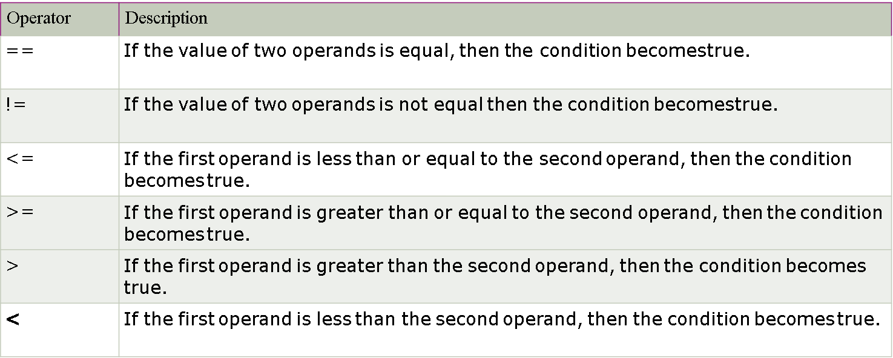
COMPARISON OPERATORS

Slide 20
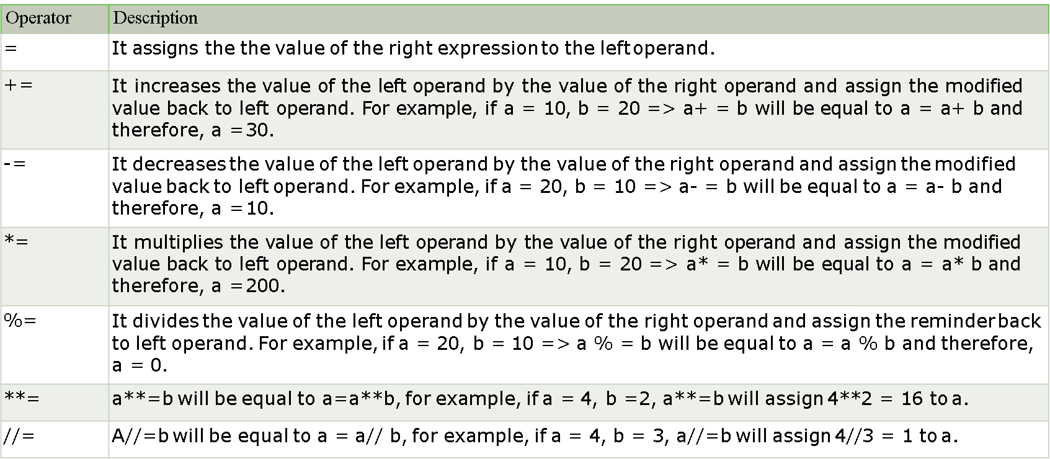
ASSIGNMENT OPERATORS

Slide 21
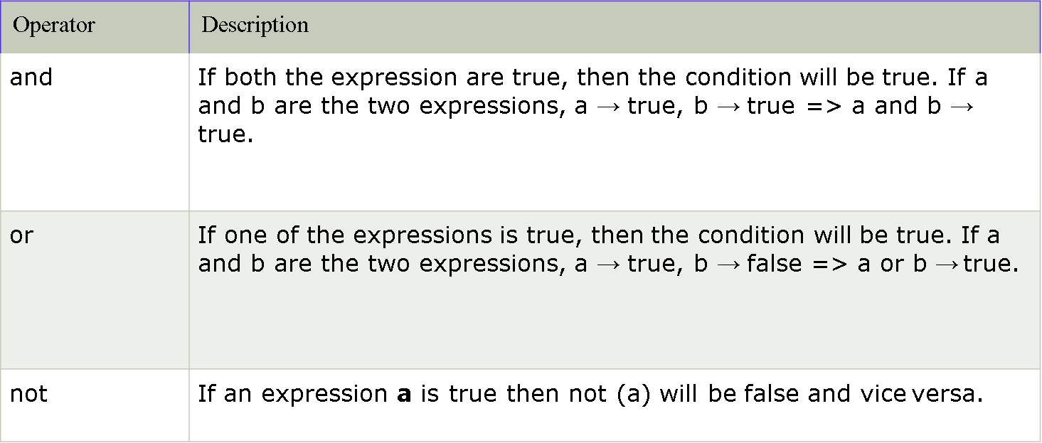
LOGICAL OPERATORS

Slide 22
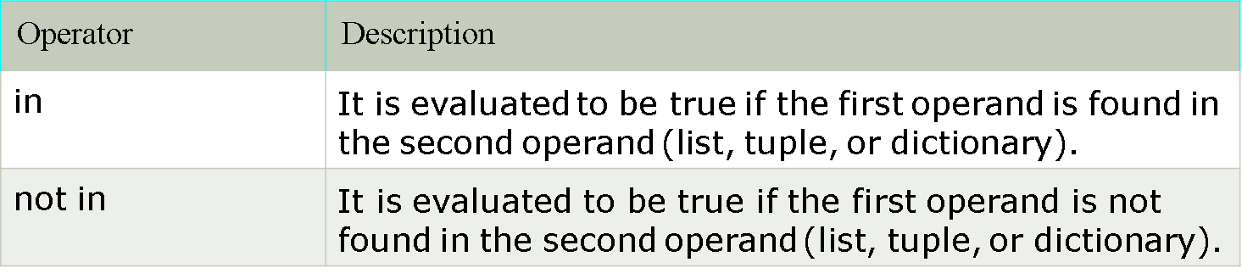
MEMBERSHIP OPERATORS

Slide 23
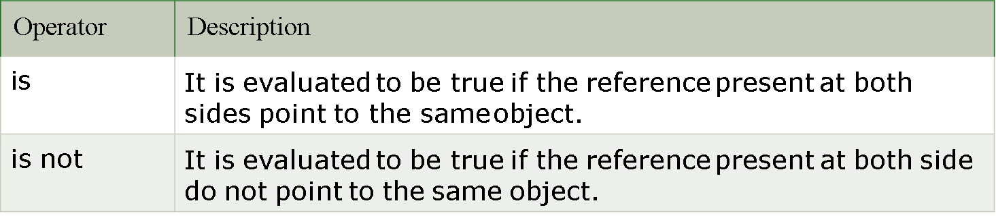
IDENTITY OPERATORS

Slide 24
CONDITIONAL STATEMENT
IF
if condition:
# code to be executed
IF-ELSE
if condition:
# code to be executed
else:
#code to be executed
IF-ELIF-ELSE
if expression 1:
# code to be executed
elif expression 2:
# code to be executed
elif expression 3:
#code to be executed
else:
# code to be executed
NESTED IF
if condition 1:
#code to be executed
if condition 2:
#code to be executed
else:
#code to be executed

Slide 25
LOOPS
It provides code re-usability.
Using loops, we do not need to write the same code again and again.
Using loops, we can traverse over the elements of data structures (array or linked lists).
While
else block- is executed when the condition given in the while statement becomes false. Like for loop, if the while loop is broken using break statement, then the else block will not be executed and the statement present after else block will be executed.
Syntax:
while expression:
statement(s)

Slide 26
For
else statement with the for loop can be executed only when all the iterations are exhausted. If the loop contains any of the break statement then the else statement will not be executed.
Syntax
for var in iterable:
# statements
range() Function
The range() function returns a sequence of numbers, starting from 0 by default, and increments by 1 (by default), and ends at a specified number.
Nested Loops
A nested loop is a loop inside a loop.

Slide 27
Pass statement in Python is used when a statement is required syntactically
but you do not want any command or code to execute.
break statement in Python terminates the current loop and resumes
execution at the next statement, just like the traditional break found in C.
Continue statement rejects all the remaining statements in the current iteration of the loop and moves the control back to the top of the loop.

Slide 28


